Slide 1



Big Data Crime Analysis
Los Angeles 2010 - present dataset
&
Chicago 2001 – present dataset
By:
Abhinav, Jesus, & Tien

Slide 2


Lab Tutorial: Analyzing Crime Data with HiveQL
A step-by-step project to process and analyze crime data using Hadoop HDFS and Hive.
This tutorial focuses on datasets from Los Angeles and Chicago, combining big data tools with HiveQL analysis.
You'll learn how to load data, run HiveQL queries, export results, and visualize them effectively.

Slide 3

Prerequisites & Setup
Before starting, ensure access to a Hadoop cluster with HDFS and Hive installed.
You’ll also need an SSH client (e.g., PuTTY), SCP tool (e.g., Git Bash), and basic knowledge of SQL.
Cluster Specs: Oracle Linux Server v. 7.9, 5 Nodes (2 Master, 3 Worker), 64GB RAM, 2.5GHz CPU for smooth data handling.

Slide 4
Step 1: Download Datasets
Datasets include crime records from Los Angeles (2010–Present) and Chicago (2001–Present).
These datasets are publicly available via city data portals and must be saved locally for transfer.
Make sure the files are large enough (>2GB total) to simulate real-world big data processing.

Slide 5
Step 2: Upload Data to Hadoop Cluster
Use SCP to transfer datasets from your local machine to the cluster’s /tmp directory.
Then SSH into the cluster and verify the upload using basic Linux commands (cd, ls).
This process simulates secure data transfer in enterprise environments.

Slide 6
Step 3: Store Files in HDFS
Use HDFS commands to create directories and store the uploaded datasets in HDFS.
This allows distributed storage and parallel processing of large files across the cluster.
Organizing files under specific folders (e.g., crime_data_LA) makes management easier.

Slide 7
Step 4: Create Hive Tables
Launch Beeline to interact with Hive and define tables for each dataset.
Tables map the CSV file structure into SQL-like schemas, enabling querying with HiveQL.
Use 'skip.header.line.count=1' to ignore CSV headers and define fields using appropriate types (STRING, INT, DOUBLE).

Slide 8
Step 5: Export Hive Query Results
Create a new Hive table to store query results in a flat CSV format.
After inserting the results into this export table, locate the HDFS path and download it.
This step simulates exporting processed data for external tools like Tableau or Excel.

Slide 9
Step 6.1: Analyze Crime Location & Time
Join location and timestamp fields (DATE_OCC, TIME_OCC, LAT, LON) to plot crime on maps.
This helps identify spatial and temporal crime trends across the cities.
Ideal for geospatial visualization in Tableau, Excel 3D Map, or Power BI.

Slide 10
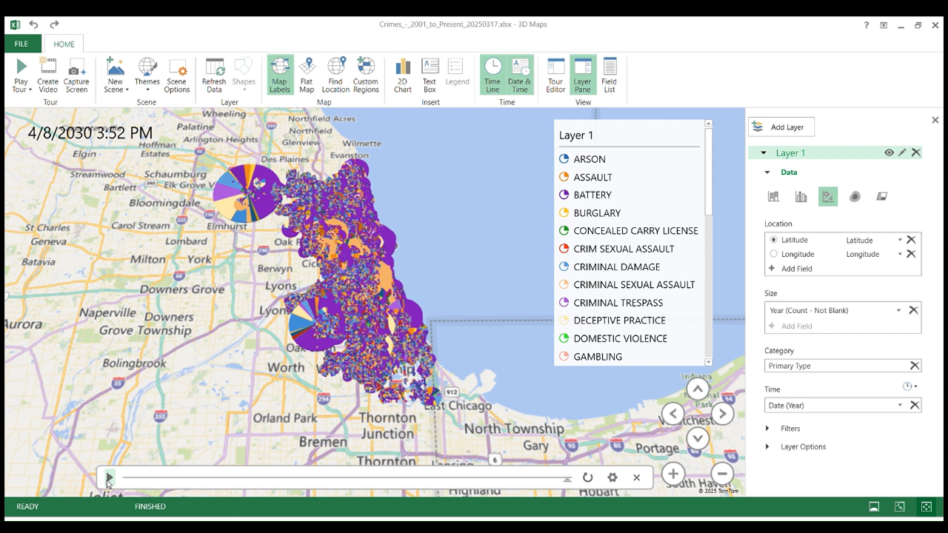
Chicago crime dataset 2001- Present

Slide 11
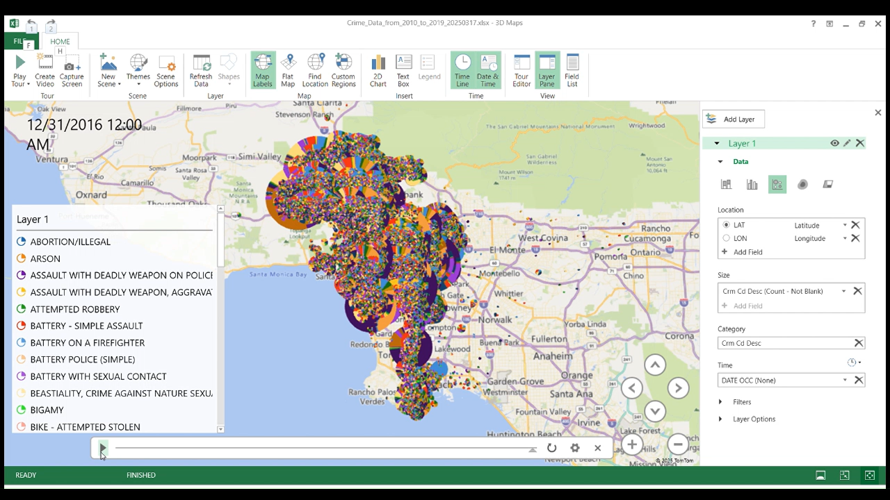
Los Angeles 2010 - Present

Slide 12
Step 6.2: Analyze Top Crime Types
Aggregate crime descriptions using GROUP BY to identify the most frequent offenses.
This analysis gives insights into common types of crime in each city.
Results are sorted by frequency using ORDER BY and displayed in bar charts or tables.

Slide 13
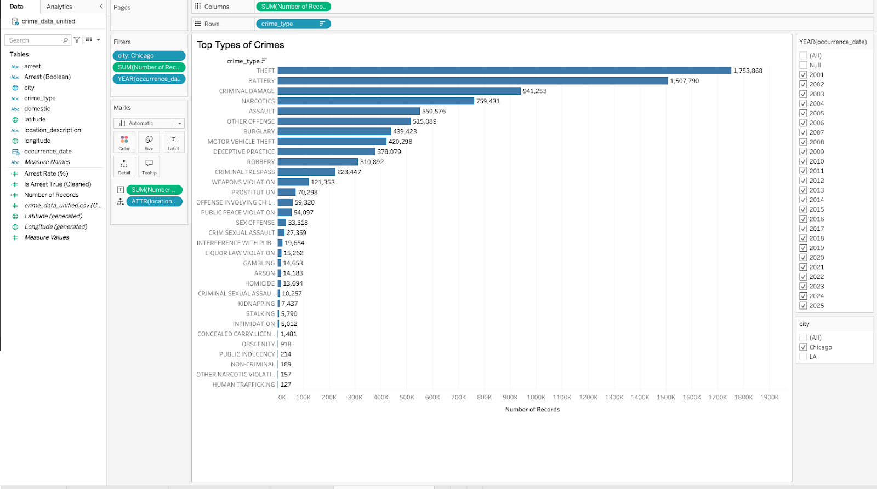
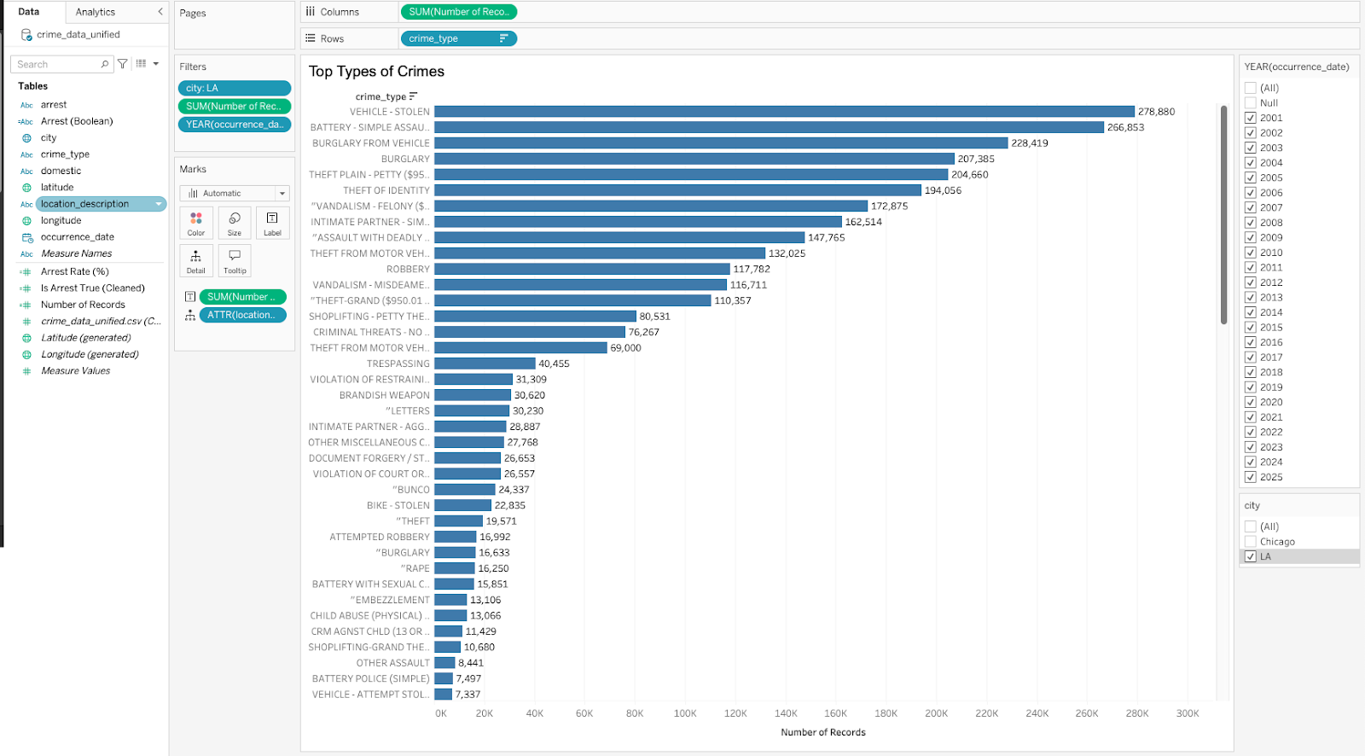
Step 6.2: Analyze Top Crime Types
Chicago
Los Angeles

Slide 14
Step 6.3: Surveillance and Arrests
Use conditional logic (CASE WHEN or CAST) to calculate the number of arrests.
Group by police district or area to analyze performance of different departments.
This informs public policy, policing strategies, and resource allocation.

Slide 15
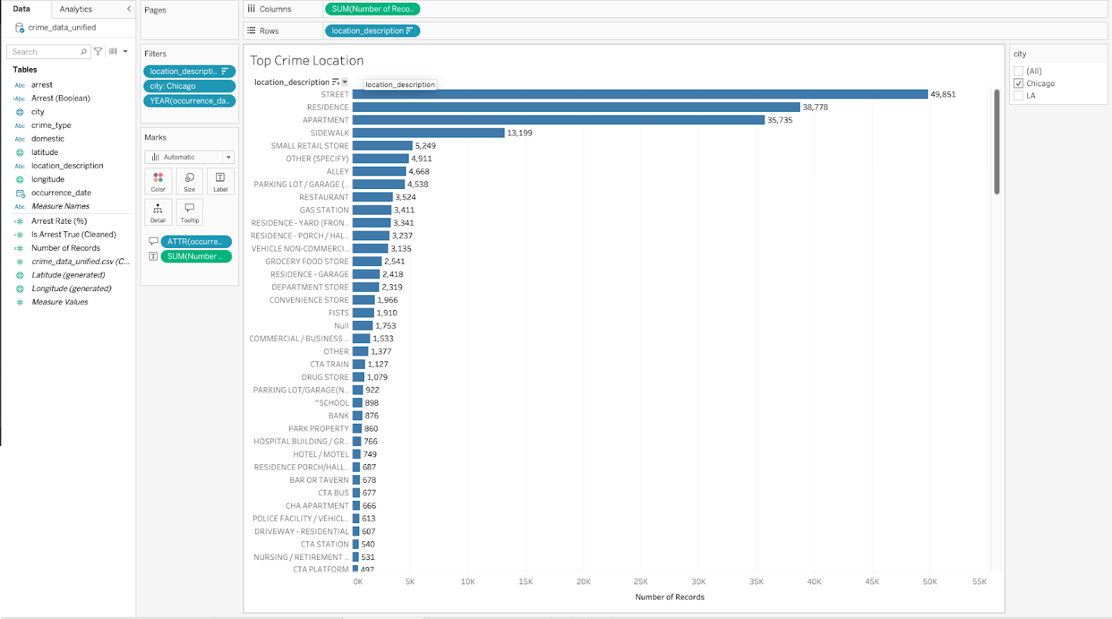
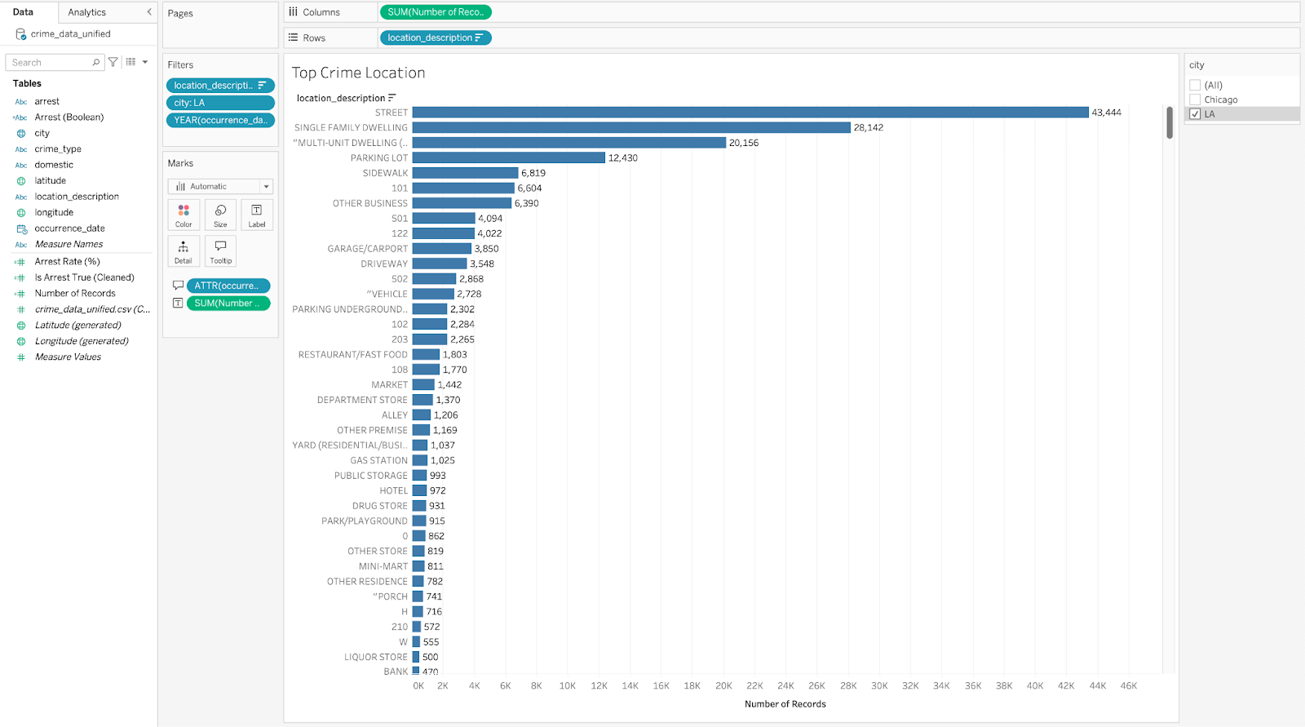
Step 6.3: Surveillance and Arrests
Chicago
Los Angeles

Slide 16
Step 6.4: Arrest Rate per Crime Type
Break down crimes by type and calculate arrest percentages for each.
Some crimes have higher arrest rates than others due to their nature or investigation complexity.
Useful for evaluating justice effectiveness across crime categories.

Slide 17
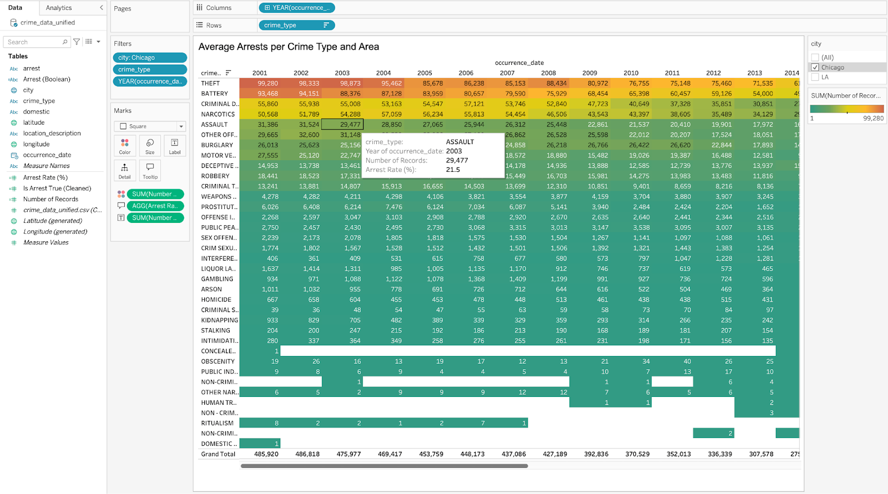
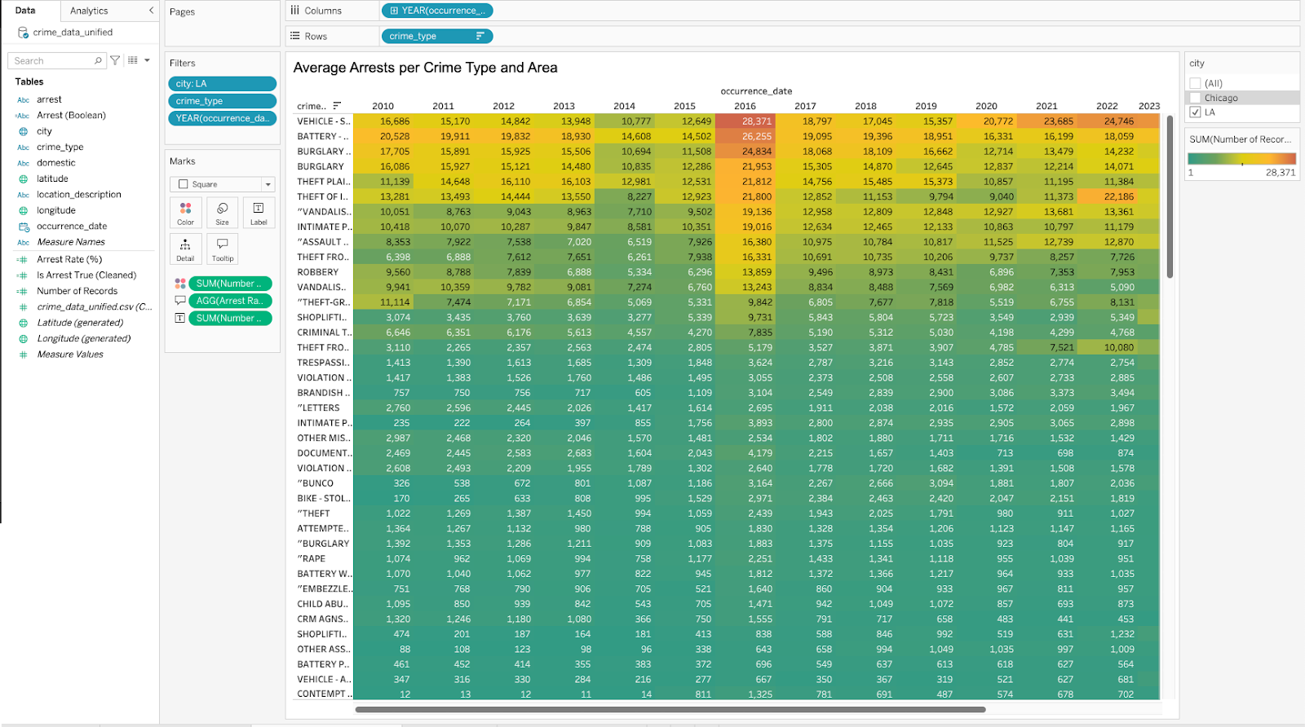
Step 6.4: Arrest Rate per Crime Type
Chicago
Los Angeles

Slide 18
Step 6.5: Crime Trends Over Time
Extract year from date fields and count incidents per year.
Visualizing this over time helps detect crime spikes or long-term trends.
Helps analysts correlate trends with policy, socio-economic events, or reforms.

Slide 19
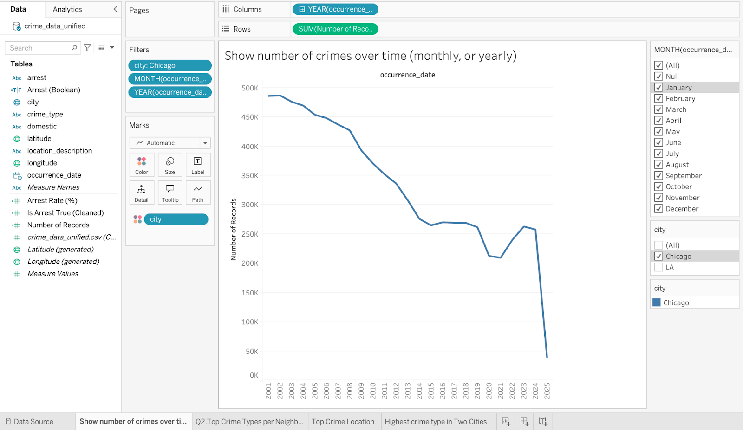
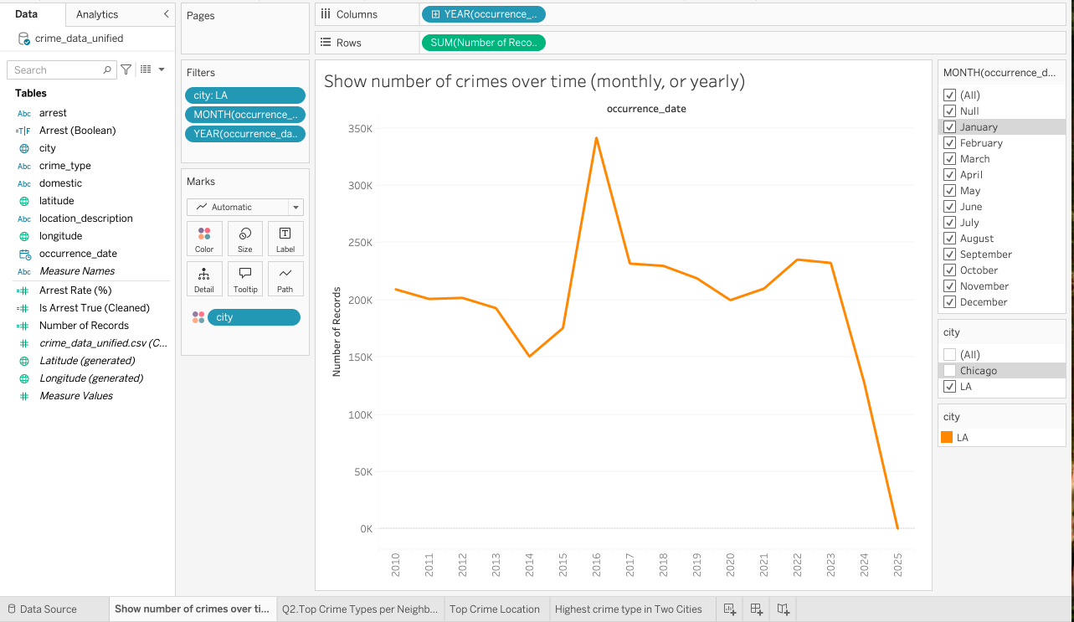
Step 6.5: Crime Trends Over Time
Chicago
Los Angeles

Slide 20
Class Relevance
Execution of HDFS shell commands along with running beeline queries.
Successfully created and populated tables in Hive QL along with extraction of the results with HIVE QL functions.
Visualized data extracted from Hive QL queries using different visualization tools like Tableau, Power Bi, and Microsoft Excel 3D Map feature.

Slide 21





Download Data Source
Upload Data to Linux Server
Run HDFS Shell Commands
Run Beeline Code
Visualize Data
(Tableau,
Power Bi
Excel 3d Map)
Crime Datasets:
Los Angeles 2010 – present
&
Chicago 2001 - present
3d Map

Slide 22
References
URL of Data source:
LA Crime Data (2020–Present): Link
LA Crime Data (2010–2019): Link
Chicago Crime Data (2001–Present): Link
2. URL of Github: https://github.com/shjepz/BigDataCrimeAnalysis

Slide 23
Team member roles
Jesus – Workflow diagram, Excel 3D Map, Power Point organizer, Dataset selector, Term Paper, Lab tutorial editor.
Abhinav – Lab tutorial organizer, Hive QL codes, GitHub organizer, Term Paper, Lab tutorial editor .
Tien – Visualization in Tableau, SCP TMP data download, HDFS shell commands, Term Paper, Lab tutorial editor.

Slide 24
QUESTIONS?

